Slide 1
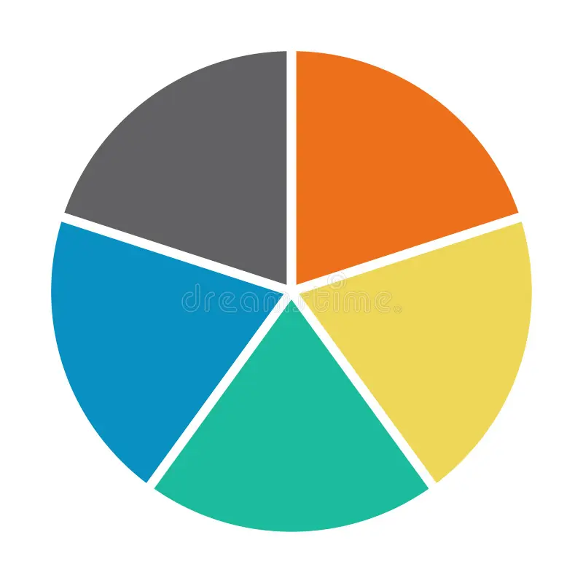
HR Analytics Project
Project Code: P716 Date: 04/01/2025

Slide 2
Introduction
Project Overview:
HR Analytics (Human Resources Analytics), also known as people analytics or workforce analytics, is the process of collecting, analyzing, and interpreting HR data to improve workforce performance and drive better business decisions. It involves leveraging data to optimize hiring, employee engagement, productivity, and retention.
Objectives:
Review the performance metrics.
Identify trends and anomalies.
Highlight areas of improvement and success.
Create Dashboard in Excel ,Power BI ,Tableau, SQL query for KPI’S .

Slide 3
Meet Our Team
Mr. Addepalli Bharath Varma
Ms. Khushi Vishwakarma
Ms. Akumalla Jahnavi
Ms. Mangala Patil
Mr. Shubham Ramesh Uppar
Mr. Harsh Burman
Mentors:
Mr. Mahendra Singh
Ms. Abirami R
Mr. Devandra Kumar

Slide 4
Agenda
Project Goal &HR Analytics Introduction
Dataset Description
Data Schema
KPI Analysis
Dashboard Design
Recommendations
Conclusion & Closure

Slide 5
Business Objectives
The aim of this project is to analyze employee retention and attrition rates with the organization and provide insights to the HR team for developing effective retention strategies. Through data analysis and visualizations, we will identify factors that contribute to :
• Employee turnover and attrition.
• Evaluate the effectiveness of existing retention strategies.
• To verify the satisfaction level of employee in the organization. • Provide recommendations to improve employee retention

Slide 6

KPI Analysis
The project focuses on analyzing key performance indicators to monitor progress and identify actionable insights. These include
Number of invoices generated by each account executive, providing insights into workload distribution and efficiency.
Comparison of targets set versus achievements, highlighting performance gaps or successes.
Tracking the total number of annual meetings to gauge engagement efforts. Identification of the top open opportunities, assessing potential revenue sources and prioritizing them.
Metrics on cross sell, new policies, and renewal rates to measure growth and client retention.

Slide 7

Dashboard Design
Tools Used:
MS Excel
Power BI
Tableau
MY SQL
Features:
Data Integration and Centralization
Predictive and Prescriptive Analytics
Performance and Productivity Metrics

Slide 8
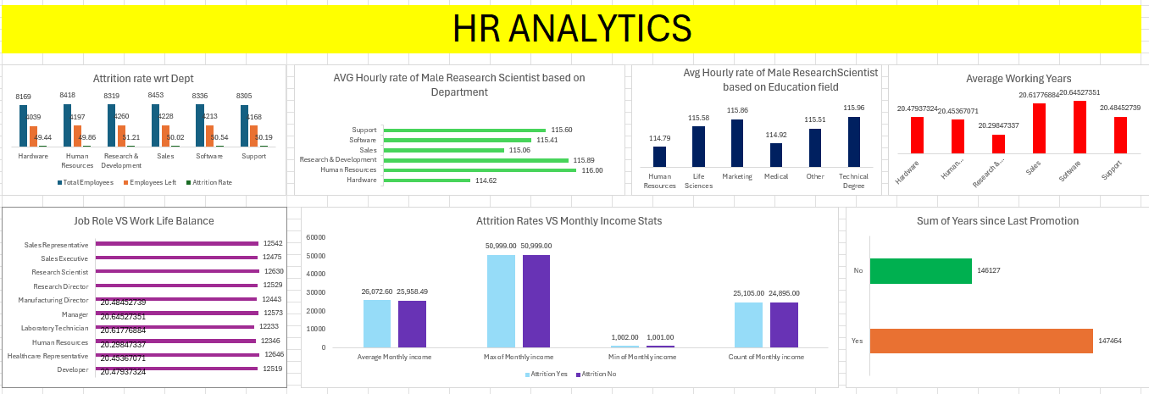
Excel Dashboard

Slide 9
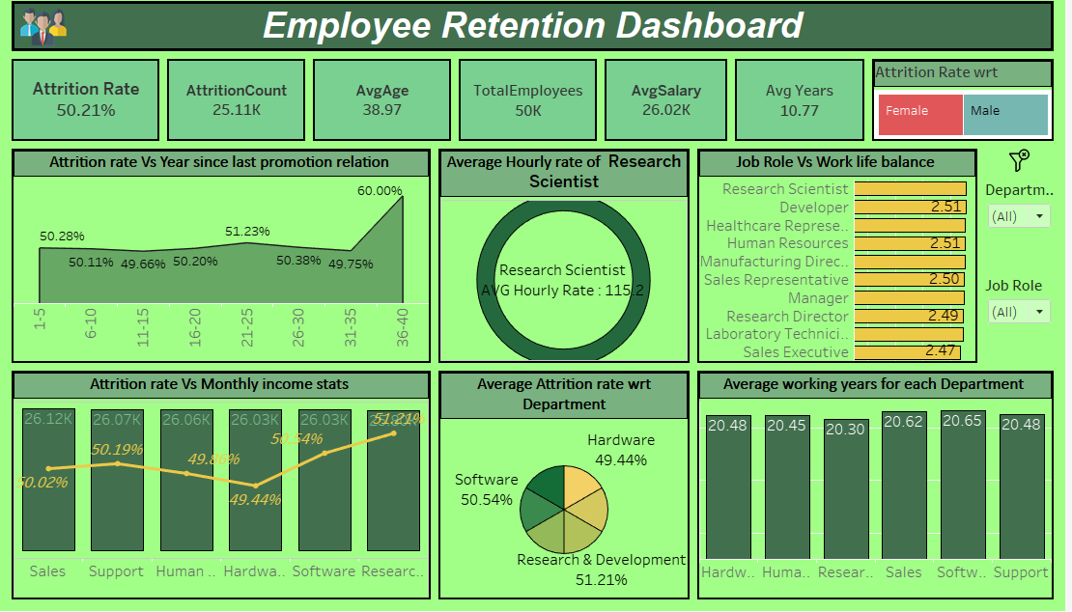
Tableau Dashboard

Slide 10
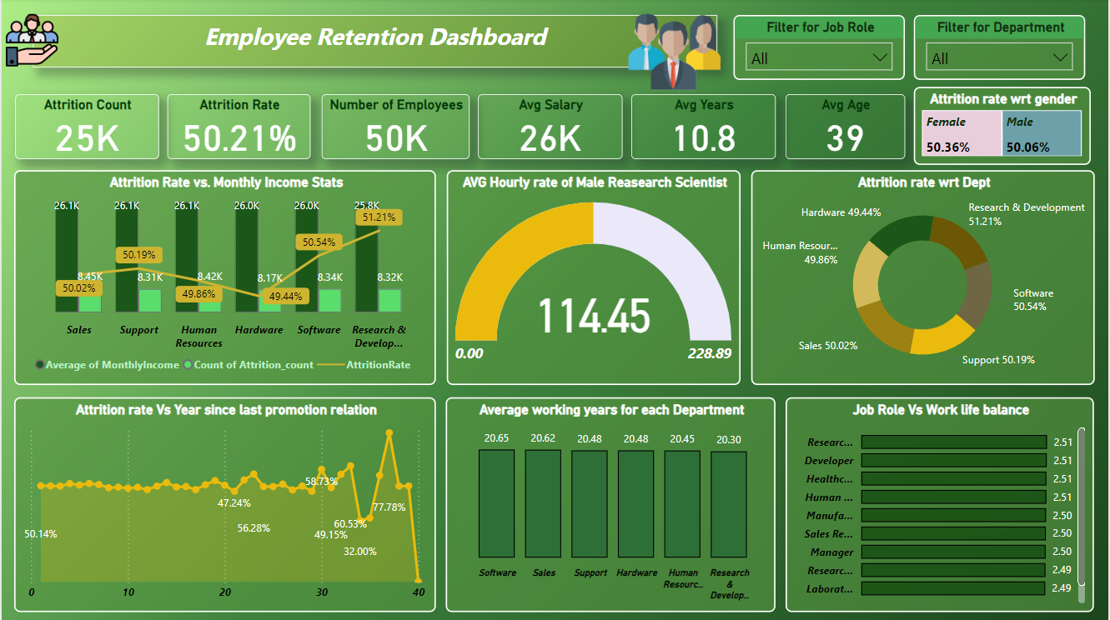
Power BI Dashboard

Slide 11
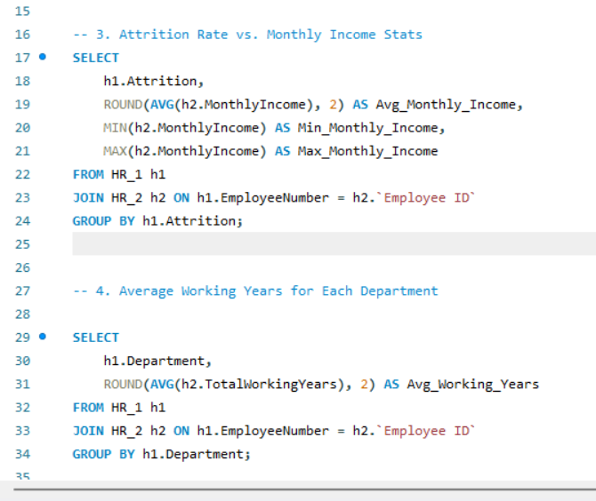
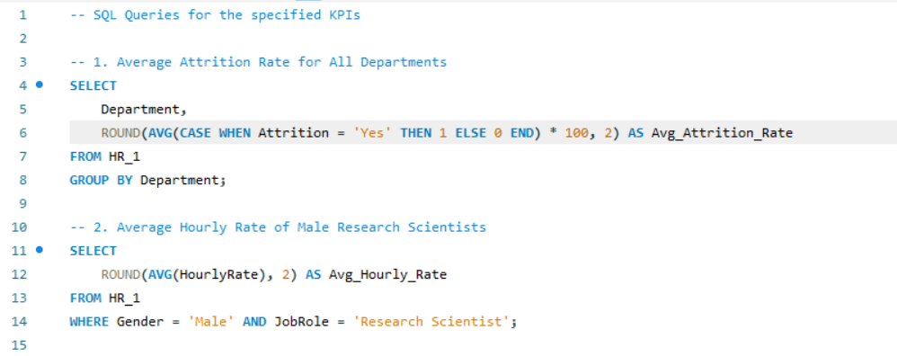
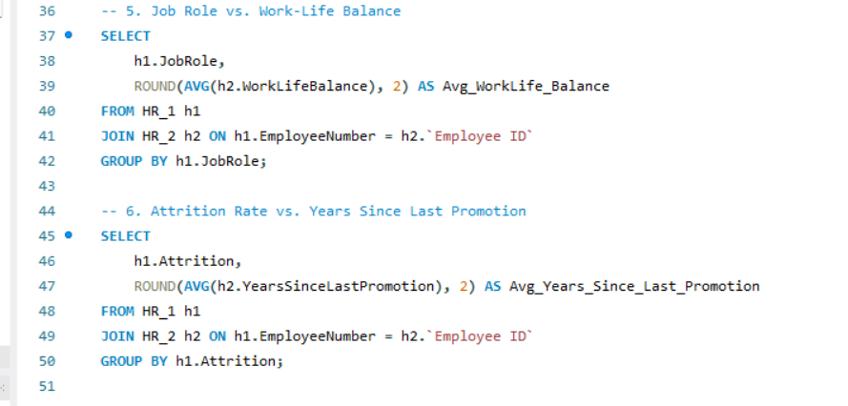
SQL Queries

Slide 12
Recommendations
1. Focus on Key HR Metrics
Recruitment Metrics: Time to hire, cost per hire, quality of hire.
Employee Engagement: Turnover rates, absenteeism, employee satisfaction.
2. Use Predictive Analytics
Forecast turnover risks and develop retention strategies.
Predict future hiring needs based on growth trends.
3. Automate Reporting
Create dashboards for real-time insights into HR KPIs.
Automate periodic reports for leadership to track workforce trends.

Slide 13

Conduct stay interviews: Instead of exit interviews, conduct stay interviews with employees to gather feedback about the job.
Create a positive work environment: Foster a positive work environment by promoting a culture of respect, inclusivity, and teamwork. Encourage open communication and collaboration among employees.
Address workload issues: Ensure employees have manageable workloads by regularly monitoring and adjusting workloads to prevent burnout and overwhelm.

